Slide 1


Department of Artificial Intelligence and Data Science
TRAIN DELAY PREDICTION USING LOGISTIC
REGRESSION
Dr.P.Indira Priya,Prof
Gopica H(231801043)
Hannah James(231801047)

Slide 2
Problem Statement
Predict train delays using historical data, including departure time, distance, and rail operators , to enhance travel planning and operational efficiency.

Slide 3
Objectives
Develop a predictive model to accurately forecast train delays.
Analyze key factors such as departure time, train distance, and rail operators.
Enhance travel planning and scheduling for passengers and trains.
Minimize disruptions caused by delays.
Improve overall operational efficiency in train travel.

Slide 4
Abstract
Train delays disrupt schedules and complicate logistics.
Predicting delays helps optimize scheduling.
This project uses logistic regression to predict delays.
Features used: distance, weather, time, train type, and route congestion.
Data preprocessing steps:
One-hot encoding for categorical variables.
Standardizing numerical features.
Model outputs a probability score to classify trains as "On Time" or "Delayed."
Performance metrics: accuracy, precision, recall, and confusion matrix.
Results indicate effective delay prediction, aiding in better scheduling and
improved passenger satisfaction.

Slide 5
Introduction
Train travel is essential for millions of passengers.
Delays can disrupt travel plans and cause frustration.
This project aims to predict train delays using historical data.
Key factors analyzed include :Departure time ,Distance ,Train operator
The goal is to enhance travel planning and improve operational efficiency.

Slide 6
Overview
Train delays affect schedules, logistics, and passenger satisfaction.
This project predicts delays using logistic regression with features like distance, weather, departure time, and route congestion.
Data is preprocessed with one-hot encoding and standardization.
The model predicts whether a train will be "On Time" or "Delayed."
Performance is measured with accuracy, precision, recall, and a confusion matrix.
Accurate predictions help improve scheduling, reduce delays, and enhance passenger experience.

Slide 7
Existing System
Many railway systems currently rely on manual tracking and historical data analysis to estimate train delays.
Some systems use rule-based approaches or simple algorithms.
These methods often lack accuracy and cannot adapt to real-time factors, such as weather changes or sudden congestion.
Existing systems may not fully account for variables like train type, route conditions, and time of day.
This results in less reliable delay predictions.
Existing System :

Slide 8
Drawback of Existing System
1. Limited Accuracy: Current systems often rely on historical data or basic rule-based methods, leading to inaccurate delay predictions.
2. Lack of Real-Time Adaptability: They fail to account for dynamic factors like weather conditions, traffic, or last-minute operational changes.
3. Inadequate Variable Integration: Many systems do not consider multiple influencing factors (e.g., time of day, route congestion) that impact delay prediction.

Slide 9
Proposed System
Proposed System :
The system uses logistic regression to predict train delays.
Key factors considered: weather, station distance, time of day, and route congestion.
Provides real-time, data-driven predictions to classify trains as "On Time" or "Delayed."
Enables optimized scheduling and better resource allocation.
Incorporates dynamic, real-time data for improved reliability and accuracy.

Slide 10
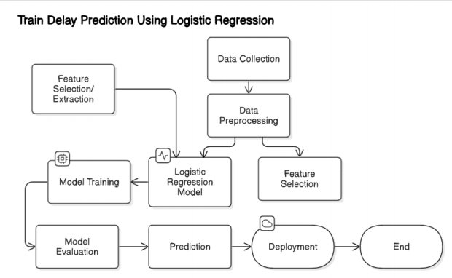
System Architecture
Data Collection: Gathers historical and real-time data (e.g., weather, schedule, route).
Data Preprocessing: Cleans, encodes, and normalizes data.
Feature Selection: Identifies key delay factors like time of day and congestion.
Model Training and Prediction: Uses logistic regression to train and predict delays.
User Interface: Allows real-time delay predictions based on user inputs.
Evaluation: Continuously improves model accuracy with feedback.

Slide 11
Data collection and preprocessing
We collect the data through the csv file (P39-Financial-Data.csv)
We now preprocess data by 1. Removing the unnecessary columns by dropping the columns 2.Check for missing values and handle them by simply filling it with NaNs with mean. 3.Now we plot the heatmap and select the most relevant features for further processes.
Separate features(X) and target(Y).
Now, Check if the target is being continuous and binarize it if necessary .
Finally, Scale the features, ensuring that no single feature dominates the learning process

Slide 12
Model Development, Training and Evaluation
Selected logistic regression for its simplicity and effectiveness in classification.
Defined target labels as "On Time" or "Delayed" based on delay thresholds.
Configured model to use features like distance, time, weather, and congestion.
Split data into training and testing sets for validation.
Trained the model on historical data, optimizing feature coefficients.
Applied regularization to reduce overfitting.
Evaluated performance with accuracy, precision, recall, and a confusion matrix.
Compared predictions to actual outcomes to assess accuracy.
Identified areas for improvement, such as feature tuning or exploring other algorithms.

Slide 13
Conclusion
This project used logistic regression to predict train delays based on factors like distance,
time, weather, and route information.
The model effectively classified delays and achieved good accuracy.
It serves as a useful tool for real-time train management.
Incorporating real-time data and exploring advanced algorithms could further
improve accuracy.
This work advances predictive analytics in transportation, offering improvements
in resource management,
operational efficiency, and passenger experience.

Slide 14
References.
Train Delay Analysis Using Logistic Regression Approach Harnoor Huda1 , Aaradhya Chaple2 Ayush Bhutada3 , Kanak Mishra4 , Shreyas Marudwar5 , Dr. Pradip Selokar
Train Delay Analysis Using Logistic Regression Approach by Kanak Mishra, Aaradhya
Chaple, Ayush Bhutada, Harnoor Huda, Shreyas Marudwar, Dr. Pradip Selokar
Delay Predicti On Using Machine Learning and Deep Learning Techniques Dr. O. Obulesu*,
Train Delay Dataset – Kaggle

Slide 15
Thank You

